Slide 1
Names and stuff

Slide 2
Motivation

Slide 3
DATA

Slide 4
Algorithms
Just write the name of three algorithms in this slide

Slide 5
STEPS BEFORE IMPLEMENTING ALGORITHM
Cleaning Data
Data Conversion
Training Data using Algorithm

Slide 6
Cleaning Data

Slide 7
Data Conversion

Slide 8
Multinomial Naïve Bayes

Slide 9
Bernoulli Naïve Bayes

Slide 10
Logistic Regression

Slide 11
Our NEW Algorithm

Slide 12
FIRST STEP

Slide 15
Second step

Slide 16
When we applied this step on our user data, we could find that no account satisfied this condition. When we applied this step on training user data, we could find 24 accounts which satisfied this condition. This can improve our accuracy by 1.626%

Slide 17
When we applied this step on our bot data, we could find 4 account which satisfied this condition. This could deteriorate our assumption and lead to a decrease in accuracy of 8%

Slide 18
THIRD STEP

Slide 23
FOURTH STEP

Slide 26
Fifth step
When we applied this condition on our user data. We recognized zero accounts satisfying this condition. This is a huge positive point for us.
Similar results were obtained when we tried on train user data, our bot data, train bot data.

Slide 27
Calculation of the accuracy
In case of user accounts:
Initially we assume the value of Value array to be 0. We change its value to 2 in the first and fifth step. Change its value to 3 in second, third and fourth step. So, during calculation of accuracy, we shall consider value 2 as 0 and rest of the values as a positive value for users.
The accuracy scores achieved on our user data was 100% and on user train data was 98.3%.

Slide 28
In case of bot accounts:
Initially we assume the value of Value array to be 1. We change its value to 2 in first and fifth step. Change its
value to 3 in second, third and fourth step.
So, during calculation of accuracy, we shall consider value 3 as 0 and rest of the valueas as a positive value for bots.
The accuracy scores achieved on our bot data was 90% and on bot train data was 64%. We achieved 64% on train bot data because it had lots of accounts which were legitimate users. We can use the same algorithm for cleaning of the bot train data.

Slide 29
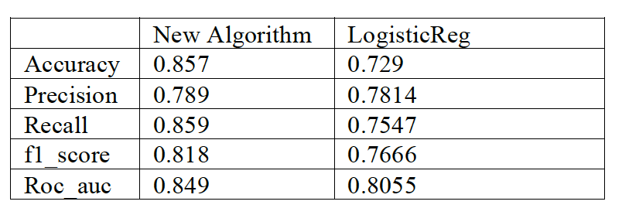
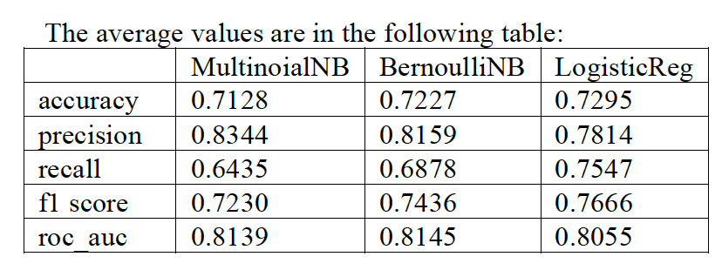
Performance and analaysis

Slide 30
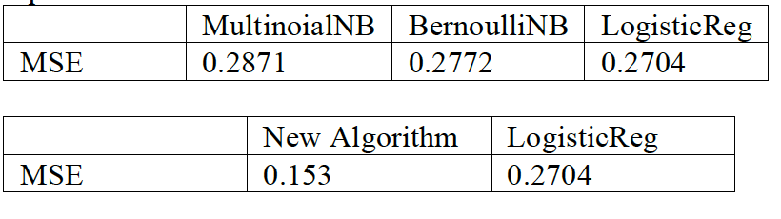

Slide 31
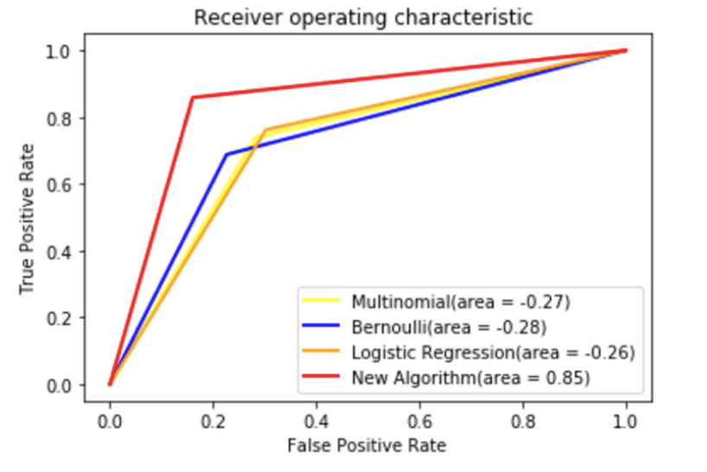

Slide 32
FUTURE WORK
Sentimental Analysis
Friends Hierarchy
User metadata
Behavior Features

